Slide 1
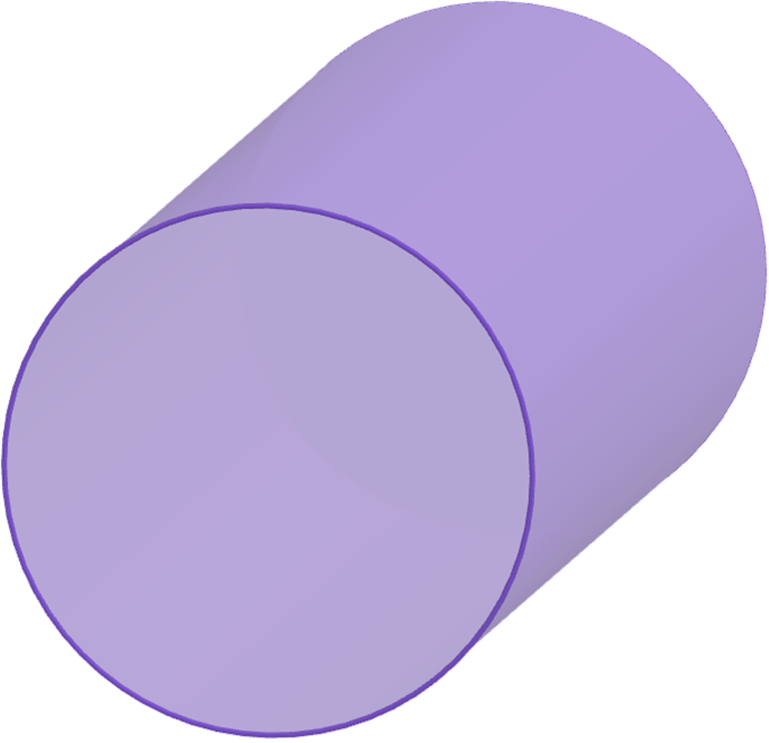
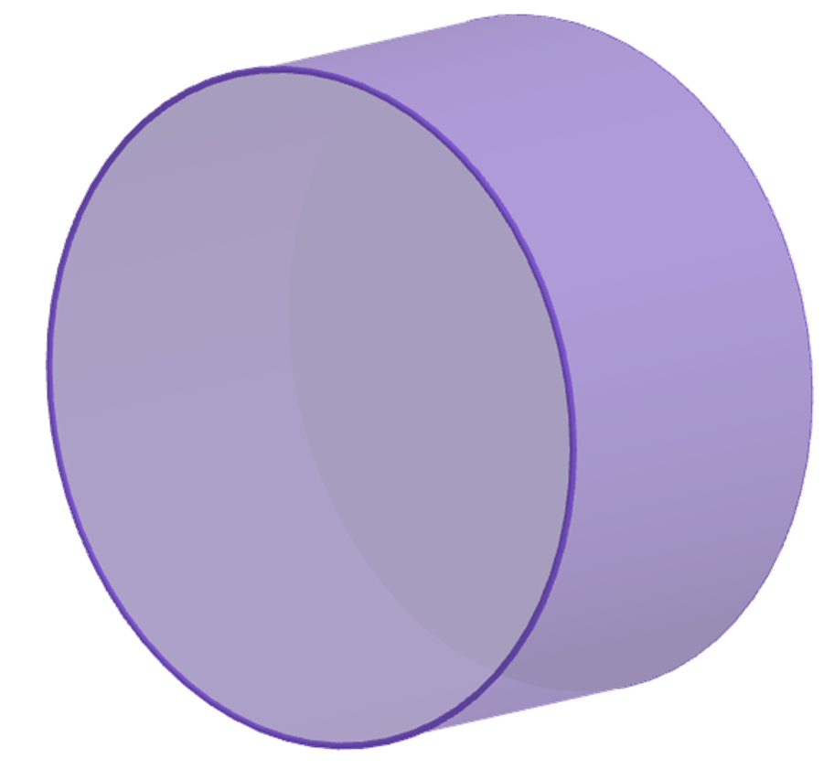
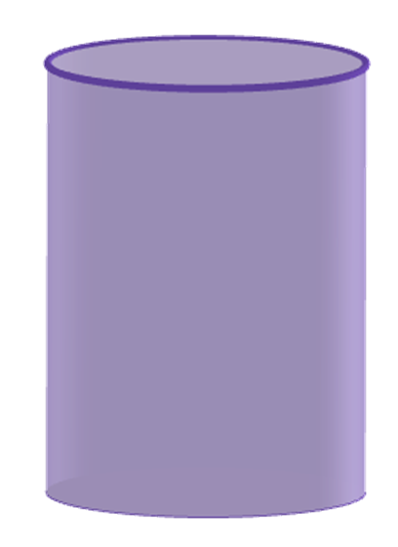
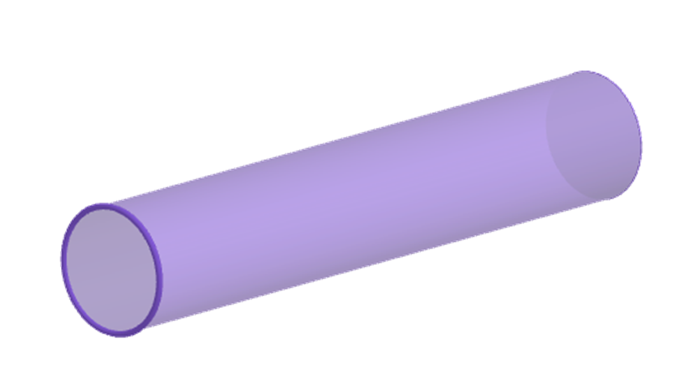
Surface area of cylinders
Task A: Finding the surface area of a cylinder
1) Work out the surface area of the following cylinders
a)
b)
4 cm
4 cm
11 cm
3 cm
Surface area
= 2 × 𝜋 × 4² + 2 × 𝜋 × 4 × 11
= 32𝜋 + 88𝜋
= 120𝜋 = 377.0 cm² (1 d.p.)
Surface area
= 2 × 𝜋 × 2² + 𝜋 × 4 × 3
= 8𝜋 + 12𝜋
= 20𝜋 = 62.8 cm² (1 d.p.)
c)
Surface area
= 2 × 𝜋 × 37² + 2 × 𝜋 × 37 × 138
= 2738𝜋 + 10 212𝜋
= 12 950𝜋 = 40 683.6 mm² (1 d.p.)
138 mm
37 mm
d)
90 cm
Surface area (working in metres)
= 2 × 𝜋 × 0.45² + 𝜋 × 0.9 × 5
= 0.405𝜋 + 4.5𝜋
= 4.905𝜋 = 15.4 m² (1 d.p.)
5 m

Slide 2
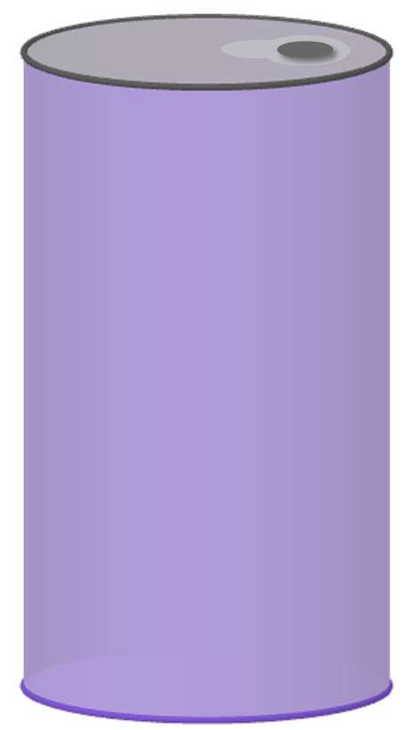

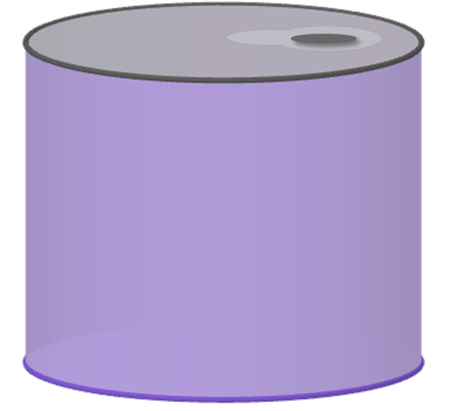
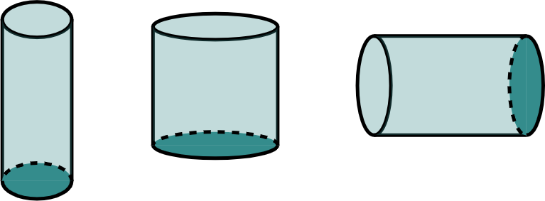
Surface area of cylinders
2) A drinks company are looking to use less material when making their cans. These two cans both hold 330 ml of liquid. Which can should the drinks company choose?
Drinks company should choose can b.
Surface area
= 8680𝜋
Surface area
= 8480𝜋
40 mm
109 mm
a
b
66 mm
62 mm
Surface area
= 2 × 𝜋 × 31² + 𝜋 × 62 × 109
= 1922𝜋 + 6758𝜋
= 8680𝜋 = 27 269.0 mm² (1 d.p.)
Surface area
= 2 × 𝜋 × 40² + 2 × 𝜋 × 40 × 66
= 3200𝜋 + 5280𝜋
= 8480𝜋 = 26 640.7 mm² (1 d.p.)
Task B: Using the surface area of a cylinder
1) Find the missing length in each question. Give your answer in cm.
3 cm
2 × 𝜋 × 3² + 2 × 𝜋 × 3 × a = 78𝜋
18𝜋 + 6𝜋a = 78𝜋
6𝜋a = 60𝜋
a cm
a = 10 cm
Surface area
= 78𝜋 cm²

Slide 3
Surface area of cylinders
12 cm
2 × 𝜋 × 6² + 2 × 𝜋 × 6 × b = 168𝜋
72𝜋 + 12𝜋b = 168𝜋
b cm
12𝜋b = 96𝜋
b = 8 cm
Surface area
= 168𝜋 cm²
c cm
2 × 𝜋 × 4² + 2 × 𝜋 × 4 × c = 88𝜋
32𝜋 + 8𝜋c = 88𝜋
80 mm
8𝜋c = 56𝜋
c = 7 cm
Surface area
= 88𝜋 cm²
2) A necklace is being made. Part of the design is a metal cylindrical rod.
The rod is gold-plated. 208𝜋 mm² of gold leaf is used. The rod has a diameter of 4 mm.
How long is the rod?
2 × 𝜋 × 2² + 2 × 𝜋 × 2 × l = 208𝜋
8𝜋 + 4𝜋l = 208𝜋
4𝜋l = 200𝜋
l = 50 mm
Mathematics in Education and Industry.
v2.2

